Slide 1
Fulbright Faculty Award
Opportunities
Christopher Lukasik
clukasik@purdue.edu
Provost’s Fellow for Fulbright Faculty Awards
Purdue University
June, 2020

Slide 2
Outbound Fulbright Faculty Awards
Contact Christopher Lukasik – clukasik@purdue.edu
Provost’s Fellow, Fulbright Faculty Awards.
Experience:
• Fulbright US Scholar Award, University of the Philippines, 2009-2010
• Fulbright National Screening Committee Member, SE Asia Region, 2011, 2012, 2014
• Fulbright Scholar Liaison, Purdue University, 2017-
• Fulbright Specialist Roster, 2017-2020
• Fulbright Specialist Grant, University of Graz, Austria, 2018

Slide 3
Fulbright US Scholar Awards
What you see here is the total number of Purdue faculty applicants and awardees for the past 9 years. On average, 1 out of every 2 faculty who apply win. In the last 3 years, the yield rate for faculty has been an incredible 60%.
Year of Award | Applicants | Awardees | Percentage
2019-2020 | 11 | 8 | 72.7
2018-2019 | 8 | 5 | 62.5
2017-2018 | 6 | 2 | 33.3
2016-2017 | 11 | 7 | 63.6
2015-2016 | 5 | 1 | 20.0
2014-2015 | 10 | 5 | 50.0
2013-2014 | 7 | 4 | 57.1
2012-2013 | 1 | 1 | 100.0
2011-2012 | 9 | 4 | 44.4
TOTAL | 68 | 37 | 54.4
AVERAGE PAST 9 YEARS | 7.5 | 4.1 | 54.4
AVERAGE PAST 3 YEARS | 8.3 | 5.0 | 60.2

Slide 4
Fulbright US Scholar Awards
1. Fulbright US Scholar Award Program
• Features over 440 2 to 12 month research, teaching, research/teaching awards in over 125 countries available to scholars across the full range of academic disciplines.
• Online application deadline of Sept. 15, winners announced in Spring of the following year.
• Applicant must be US citizen.
• There is a Flex Option which allows allows for multiple visits to the same host country over short segments (only available in 63 countries and 2 world areas)
• There is also a Global Scholar Award: These are highly competitive awards (there are only 20 in the US) which allow for multiple visits to 2-3 countries (3 to 6 months total with a minimum of one month spent in each host country, each visit; only available in designated countries).
• For more information on the Fulbright Award Program, see https://www.cies.org/program/core-fulbright-us-scholar-program
• For more information on the catalogue of awards, see https://awards.cies.org

Slide 5
Fulbright US Scholar Award Timeline
Successful applicants typically work two years backwards from the AY they plan on arriving in the host country. If you plan to be in Spain in Fall 2021, the process should begin ideally in Fall 2019. But it’s not too late! The deadline remains Sept. 15, 2020.
1
2
3
4
5
What do you want to do and where do you want to go?
Identify specific award, refine project, and notify Unit Head and Provost’s Office
Apply
Peer Review and Selection
2 years prior
Fall 2019
2 years prior
Spring 2020
1 year prior
Sept. 15, 2020
1 year prior
Fall 2020 / Spring 2021
AY of Grant
2021-2022

Slide 6
Sample of Fulbright Scholar Awards: Engineering
Code | Award Title | Country | Activity
11153-EZ | Fulbright-Czech Technical University Distinguished Chair in Electrical Engineering | Czech Republic | Teaching or Teaching/Research
11533-IT | Fulbright Jr. Research Lectureship at the Dept. of Industrial Engineering at the University of Trento | Italy | Teaching/Research
11067-AS | Fulbright Distinguished Chair in Advanced (Defense) Science and Technology (DST) | Australia | Research
11433-CO | Fulbright-Universidad Nacional de Colombia Distinguished Chair in Biodiversity and Sustainable Development | Colombia | Research or Teaching/Research
11169-FI | Fulbright-Aalto University Distinguished Chair (Engineering) | Finland | Teaching/Research
11521-UK | US Friends of Queen’s University Belfast Visiting Professorship | UK | Research

Slide 7
Sample of Fulbright Scholar Awards: Technology
Code | Award Title | Country | Activity
11607-CA | Research Chairs in Science and Technology | Canada | Teaching or Teaching/Research
11391-AR | Science and Technology | Argentina | Teaching or Teaching/Research
11290-SW | Fulbright Distinguished Chair in Alternative Energy Technology | Sweden | Teaching or Teaching/Research
11161-FI | Fulbright-Nokia Distinguished Chair in Information and Communications Technologies | Finland | Teaching/Research
11169-FI | Fulbright Scholar Award (University of Technology Sydney) | Australia | Research
11331-UK | Fulbright-Lancaster University (STEM-Science and Technology) | UK | Research

Slide 8
Fulbright Specialist Grants
2. Fulbright Specialist Program
• Program pairs highly qualified U.S. academics with host institutions abroad to share their expertise, strengthen institutional linkages, hone their skills, and gain international experience.
• There are no specific awards, just projects which are funded.
• Faculty apply to be named to the Fulbright Specialist Roster. If selected, they are on the roster for a period of 3 years and can then be paired either with open projects from host institutions around the world or with a specific project developed by the specialist with an international colleague/host institution in advance.
• Costs are shared between Fulbright and host institution, host country education agency.
Fulbright supplies roundtrip airfare, local transport to airport, and a stipend for the specialist.
Host institution supplies local transport, per diem, and housing for the specialist.

Slide 9
Fulbright Specialist Grants
2. Fulbright Specialist Program
• Funded projects are for 14 to 42 days (2-6 weeks) over a period of 1 to 2 years
• Eligible disciplines include areas in: Agriculture, Science, Humanities, Social Sciences, Engineering, Management, Health Science, and Library Science.
• There is a rolling deadline; applications to be named to the Specialist Roster are reviewed seven times a year.
• More information at https://fulbrightspecialist.worldlearning.org

Slide 10
Fulbright Specialist Grants
What kinds of projects are funded?
• Delivering a seminar or workshop
• Consulting on faculty or workforce development
• Developing academic or training curricula and materials
• Lecturing at the graduate or undergraduate level
• Conducting needs assessments or evaluations for a program or institution
What is the application timeline?
1. Faculty member applies to be named to Fulbright Specialist Roster
2. Get project approved by host Institution/Host Country
3. Eligible individuals on the Fulbright Specialist Roster matched to host institution projects
4. Final approval by the J. William Fulbright Foreign Scholarship Board
5. Fulbright Specialist implements project abroad with host institution

Slide 11
Fulbright Specialist Grants
2. Fulbright Specialist Program
• Faculty apply to be named to the Fulbright Specialist Roster. If selected, they are on the roster for a period of 3 years and can be paired with either open projects from host institutions around the world or with a specific project developed by the Specialist with an international colleague and a host institution in advance.
• There are two ways in which faculty can be paired with a project at a host institution.
1. Apply to be paired with an open project on the World Learning website. Host institutions are need in of faculty with your expertise to work on projects throughout the world.
2. Work with an existing international partner and their host institution to develop a specific project and get that project approved and funded by the appropriate host country Fulbright entity and World Learning.

Slide 12
Fulbright Specialist Grants
Purdue has been very successful in the Fulbright Specialist Program. 92% of faculty have been named to the Specialist roster; and 72% of those on the Specialist Roster have been awarded grants to host countries.
Year of Fulbright Specialist Application | # of Purdue Faculty Applied | # of Purdue Faculty Named to Fulbright Specialist Roster | # of Purdue Faculty Awarded Fulbright Specialist Grant
F 2017 | 2 | 2 | 1
S 2018 | 3 | 3 | 2
F 2018 | 4 | 4 | 3
S 2019 | 6 | 6 | 4
F 2019 | 3 | 3 | 3
S 2020 | 7 | 5 | 4
Total | 25 | 23 | 18

Slide 13
Fulbright Specialist Grants COVID 19 Update
2. Fulbright Specialist Program COVID 19 Update
• On March 12, 2020, the U.S. Department of State temporarily suspended the Fulbright Specialist Program and postponed all Fulbright Specialist projects that had not yet commenced. Any individuals who were on the Roster as of March 12, 2020 will receive an extension to their current Roster tenure of 1 year and 60 days.
• Faculty, however, can still apply to be named to the Specialist roster. If faculty are named, their 3 YEAR tenure on the roster will not start until the program resumes. The deadlines for the Specialist Program are rolling (upcoming deadlines and notification dates for 2020 are posted in the next slide).
• More information at https://fulbrightspecialist.worldlearning.org

Slide 14
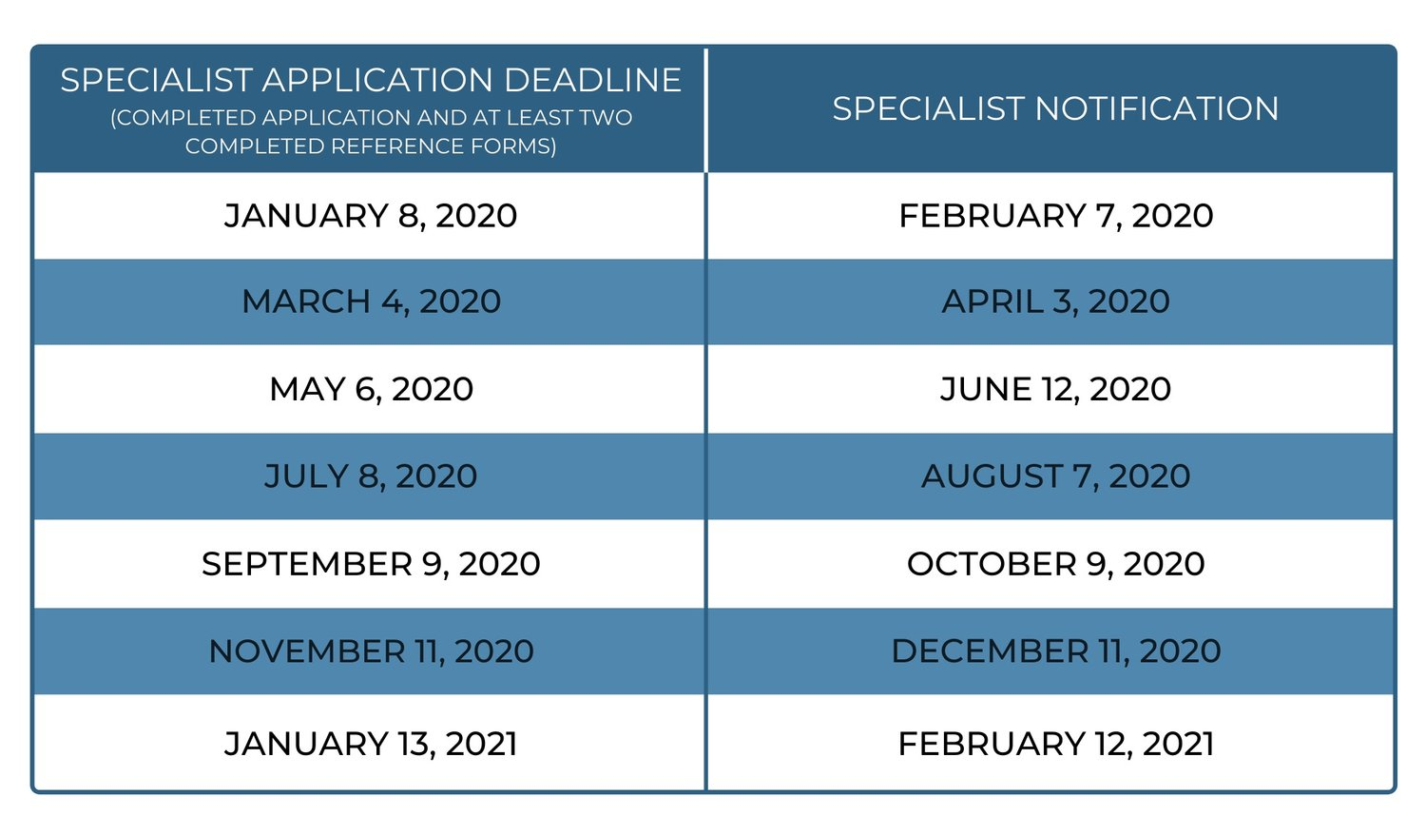
Fulbright Specialist Grants 2020 Timetable

Slide 15
What I Can Do To Help
1. Consult with faculty in selecting the right award.
2. Assist faculty through the application and post-award process.
3. Review individual application materials of faculty (voluntary process) before the September 15 application deadline and in advance of any Specialist roster deadline.
4. Target and recruit faculty for Fulbright awards
5. Raise awareness of the Fulbright Award Programs to faculty across campus, answer questions, and share faculty disincentives with the Provost’s Office.
Simply contact me at clukasik@purdue.edu

Slide 16
What You Can Do
1. Plan Early: I am available to consult with faculty about the selection, application, and award process. Contact me at clukasik@purdue.edu
2. Notify Your Department Head and me as soon as you know you will apply.
3. Raise Awareness. Let your colleagues know about my position and about Purdue’s new Fulbright salary top-off policy, which addresses many questions concerning salary, benefits, and procedures. See https://www.purdue.edu/provost/policies/fulbright.html
4. Apply! In 2019-20, 8 out of 11 Purdue faculty won, breaking the record for most Fulbright Scholars in a year at Purdue.
5. Communicate. Let me know when you apply to Fulbright or when you win an award. Contact me at clukasik@purdue.edu. Or, alternatively, let me know why you chose not to apply. Are there still faculty disincentives that Purdue needs to address?

